Slide 1
Barcelona or Madrid?
Segmenting and clustering the neighborhoods of two cities

Slide 2
Purpose of this analysis
It is often hard to decide which city to visit and how you can compare them
Which city has more to offer? How are the different?
This analysis will help make that decision and answer those questions by analyzing neighborhoods of Barcelona and Madrid by segmenting and clustering

Slide 3
Data for the analysis
Sources:
Madrid: https://es.wikipedia.org/wiki/Anexo:Distritos_de_Madrid
Barclona: https://es.wikipedia.org/wiki/Distritos_de_Barcelona
From these sources I will create two datasets for each city, which will include districts, neighborhoods and their latitude and longitude.
Then, I will use Foursquare API to explore most popular venues and then segment and cluster neighborhoods.

Slide 4
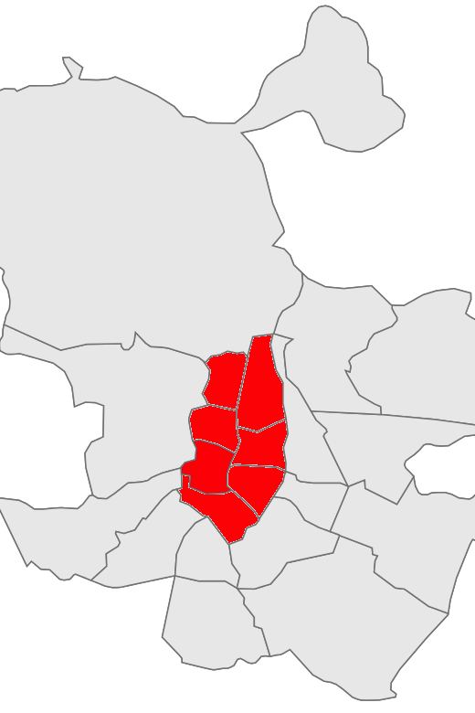
Districts of Madrid used for this analysis
Centro
Arganzuela
Retiro
Salamanca
Chamartin
Tetuan
Chamberi
Total area of these districts is around 41,74 km2.

Slide 5
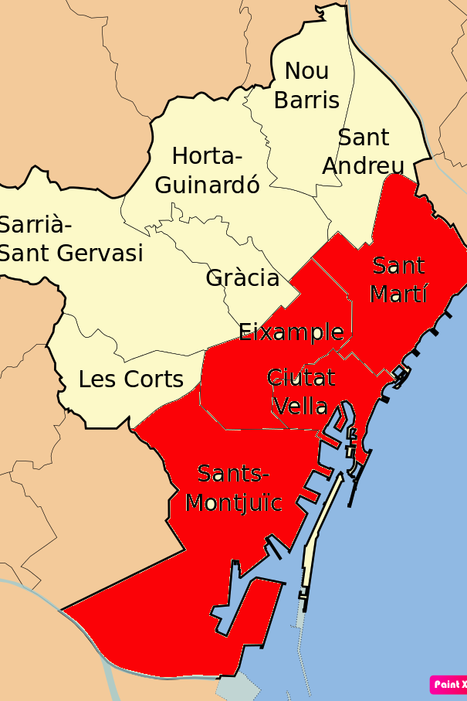
Districts of Barcelona used for this analysis
Ciutat Vella
Eixample
Sants – Montjuic
Sant Marti
Total area of these districts is around 44,1 km2.

Slide 6
Methodology
Creating two dataframes for Madrid and Barcelona in Jupyter Notebook
Using Foursquare API to explore most popular venues
Segmenting and clustering neighborhoods of two cites

Slide 7
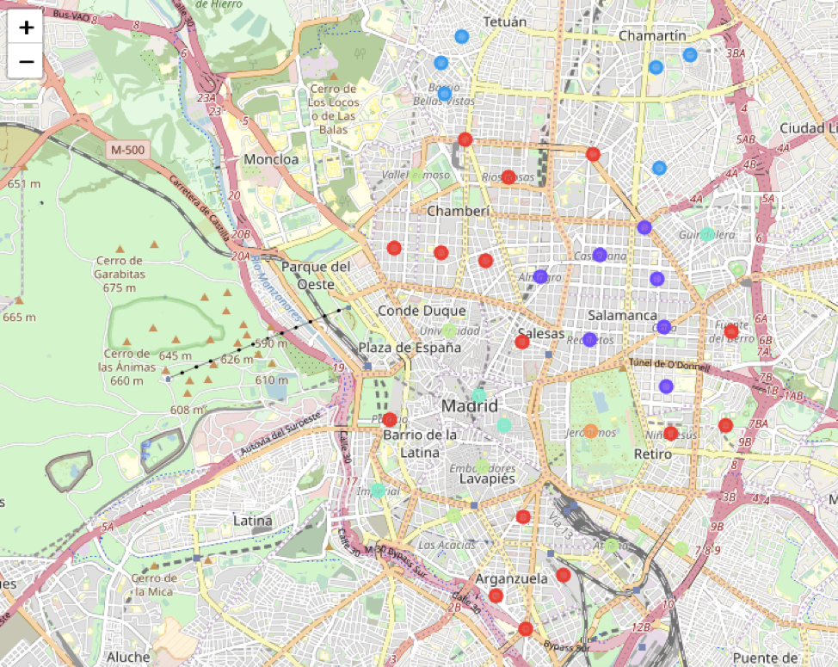
Clusters of Madrid: 6

Slide 8
Cluster 0 (Red): 15 neighborhoods out of 42
Restaurants/food | 66
Bars, breweries | 22
Coffee shops, bakeries, ice cream shops | 18
Historic sites, plazas, museums, art galleries, theaters | 10
Parks | 5
Other (supermarkets, stores, hotels, etc.) | 29
This cluster is the largest one and mainly consists of restaurants, bars and coffee shops. It’s important to notice that there also are a lot of historic sites, museums and art galleries and parks. Location: closer to city center.

Slide 9
Cluster 1 (Violet): 8 neighborhoods out of 42
Restaurants/food | 51
Hotels | 6
Stores (jewelry, clothing, etc.) | 5
Coffee shops, bakeries, ice cream shops | 8
Other (supermarkets, nightclubs, bars, etc.) | 10
This cluster consists of vast majority of restaurants, there are some coffee shops, hotels and shopping malls. No historic sites or parks.

Slide 10
Cluster 2 (Blue): 7 neighborhoods out of 42
Restaurants/food | 28
Bars | 9
Supermarkets, grocery stores | 9
Coffee shops, bakeries, ice cream shops | 12
Other (gyms, stores, plazas) | 12
This cluster includes restaurants, coffee shops, bars same as Cluster 0, but the difference is that it also has a lot of supermarkets and grocery stores. You can see from the map, that this cluster is further away from city center, this probably means that a lot of local people actually live there.

Slide 11
Cluster 3 (Light Blue): 4 neighborhoods out of 42
Restaurants/food | 14
Bars | 5
Hotels | 4
Historic sites, plazas, museums, art galleries, theaters | 7
Other (coffee shops, parks, supermarkets) | 10
3 neighborhoods of this cluster are in a city center and one further away. It consists of restaurants, historic sites, museums, bars and hotels. It differs from Cluster 0 – it has more hotels, fewer coffee shops, parks, but has great concentration of art galleries and museum.

Slide 12
Cluster 4 (Green): 8 neighborhoods out of 42
Restaurants/food | 37
Bars | 10
Coffee shops, bakeries, ice cream shops | 13
Historic sites, plazas, museums, art galleries, theaters | 10
Other (hotels, parks, supermarkets) | 10
Part of this cluster is in a city center, the other is a bit further. It mainly consists of restaurants, coffee shops, bars and museums, art galleries and plazas. The difference from Cluster 0 is that the proportion of cultural sites is much bigger here.

Slide 13
Cluster 5 (Orange): 1 neighborhood out of 42
“Green” neighborhood – park, fountain, monument, art museum, restaurants.

Slide 14
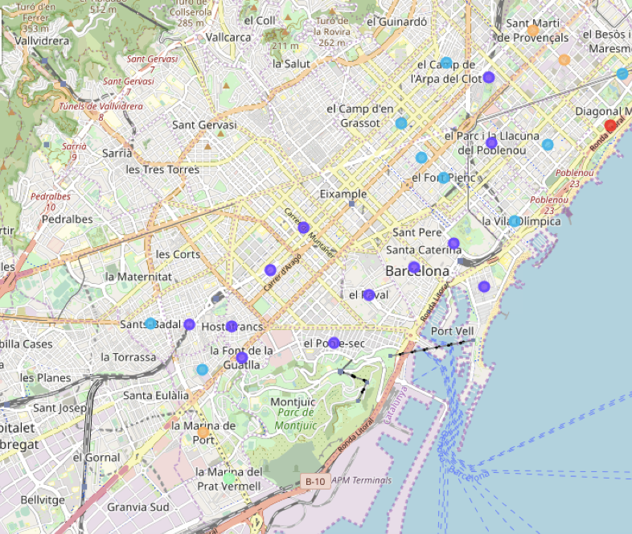
Clusters of Barcelona: 5

Slide 15
Cluster 0 (Red): 1 neighborhood out of 25
“Beach” neighborhood – beach, restaurants, bars and coffee shops.

Slide 16
Cluster 1 (Violet): 12 neighborhoods out of 25
Restaurants/food | 59
Bars, breweries | 25
Coffee shops, bakeries, ice cream shops | 14
Hotels | 9
Other (supermarkets, stores, historic sites, etc.) | 13
This is the largest cluster; it locates mostly in the city center. The dominant venue here is restaurant, but cluster also has a lot or bars, coffee shops and hotels.
We can also notice that there aren’t many museums, art galleries or historic sites in a contrast to Madrid. Instead, Barcelona has more bars and restaurants to offer.

Slide 17
Cluster 2 (Blue): 9 neighborhoods out of 25
Restaurants/food | 47
Bars, breweries | 6
Coffee shops, bakeries, ice cream shops | 16
Hotels | 7
Other (supermarkets, stores, historic sites, etc.) | 14
This cluster is further away from city center. It also has a lot of restaurants, coffee shops, hotels and bars.

Slide 18
Cluster 3 (Green): 1 neighborhood out of 25
Restaurants and stores

Slide 19
Cluster 4 (Orange): 3 neighborhoods out of 25
Restaurants/food | 10
Coffee shops, bakeries, ice cream shops | 5
Hotels | 2
Other (supermarkets, stores, bars, etc.) | 13
The last cluster is the most remote from the city center. It also consists mainly of restaurants, coffee shops and some hotels.
You can notice, that Barcelona clusters mostly differ by their location, but consists of more or less the same venues: restaurants, coffee shops, bars and hotels.

Slide 20
Discussion
Clusters of Barcelona mostly differ by their location, but consist of the same venues: restaurants, coffee shops, bars and hotels.
As it was mentioned before, there is a difference between Madrid and Barcelona due to their location – Barcelona has a “beach” and “harbor” clusters.
In contrast, Madrid clusters differ not by their location, but their content. So, we can say that Madrid has more diverse neighborhoods than Barcelona.
Madrid has a lot more plazas, museums and art galleries to offer.
Madrid also seem to have more parks than Barcelona.
Barcelona has a large variety of restaurants and bars, their proportion is much bigger here, than in Madrid clusters.

Slide 21
Conclusion
MADRID
If you prefer to explore museums and art galleries during your trips and enjoy a walk in a park – Madrid is the right choice. Madrid neighborhoods are very diverse, so you can find everything you might need – a hotel, restaurant, coffee shops, grocery store, bar, nightclub and so on.
BARCELONA
The neighborhoods of Barcelona consist of the same venues, but offer a larger choice of restaurants and bars, so it should be your choice if you’re seeking to explore local food and drinks. Also, if you are looking for a vacation by the beach or your goal is to see some Gaudi architecture, the answer is obvious, and this analysis did not cover these facts.

